Slide 1
Solar System Simulator
Casper – Lead Programmer
Stefan – UX VFX
Stanley – Lead Artist
Thimo – UX UI
Daniël – Producer

Slide 2
Inhoud
Opdracht
Ons idee
Style Guide
Mechanics
U.X.
Questions

Slide 3
Opdracht
True to scale
Info screens
Easy to use

Slide 4
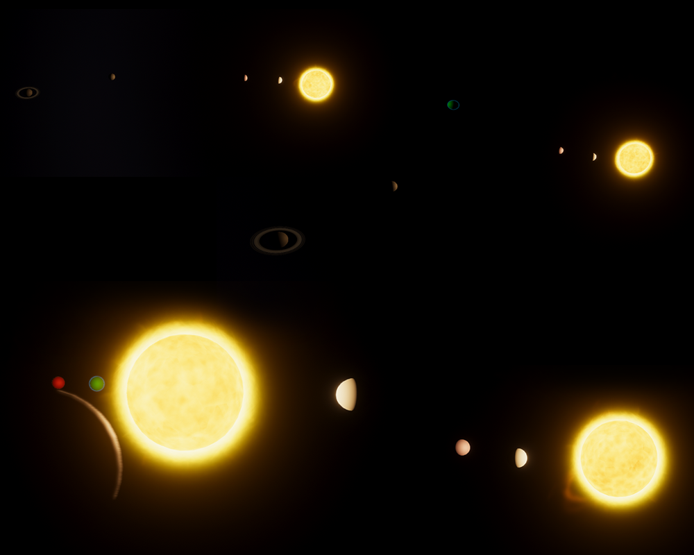
Ons idee
VR
Linker hand: info
Rechter hand: interact

Slide 5
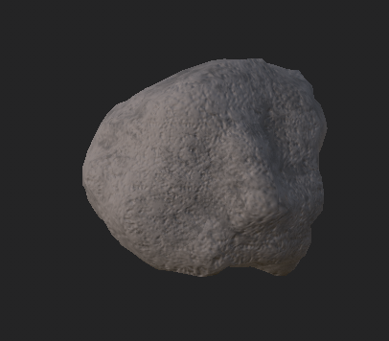
Style guide
Realistisch graphics & lighting

Slide 6
Mechanics
Teleport based travel
Map view for ease of use
Elite Dangerous style indicators

Slide 7
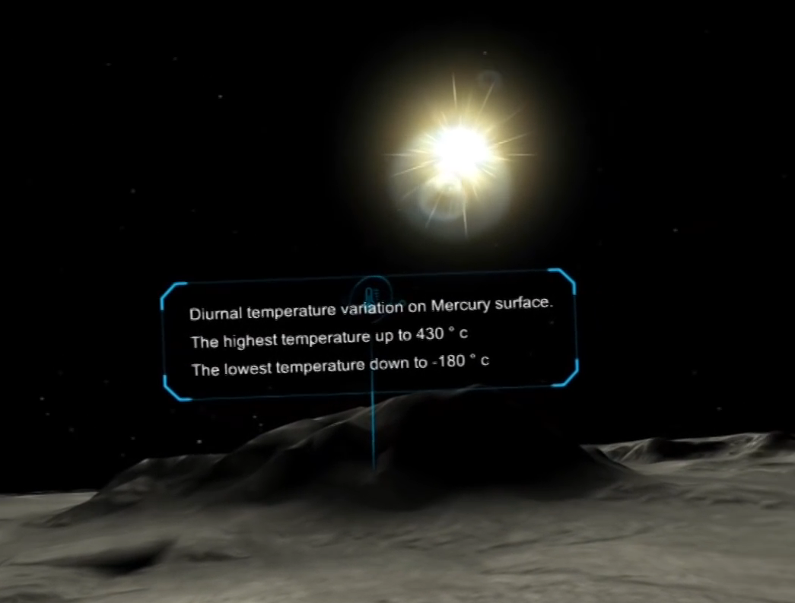
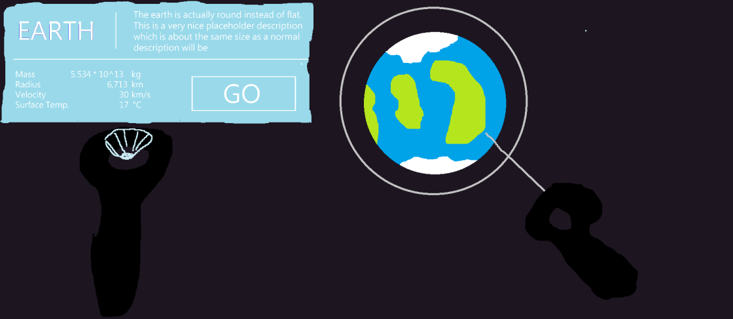
u.x.
Holo display UI
Lighting

Slide 8
Questions

